Slide 1

A Comprehensive Classification System for Alzheimer's Disease
The TRIDENT
AMRITA VISHWA VIDYAPEETHAM, SCHOOL OF ENGINEERING, CHENNAI CAMPUS

Slide 2
Team Members
Bode Vamsi Krushna - 3rd year AIE
Paayas P - 3rd year AIE
Sarthak Yadav - 3rd year AIE

Slide 3
Problem Statement
Alzheimer's is a neurodegenerative disorder affecting millions of people worldwide, and early detection of the disease can lead to better treatment and management of the symptoms. This project aims to develop a machine-learning model that can accurately classify individuals as either having Alzheimer's disease or being cognitively normal, based on various demographic, clinical, and neuroimaging features. The development of an accurate classification model can have significant clinical implications and improve the quality of life for those affected by the disease.

Slide 4
Dataset
This project makes use of Alzheimers-Disease-5-Classification-Dataset-ADNI.
The goal of the ADNI-5 classification task is to develop a machine learning model that can accurately classify individuals as having Alzheimer’s Disease, Cognitively Normal, Early Mild Cognitive Impairment, Mild Cognitive Impairment, or Late Mild Cognitive Impairment based on their MRI scans and clinical data
The ADNI-5 dataset provides a valuable resource for developing and evaluating machine learning models for the early detection and classification of AD.

Slide 5
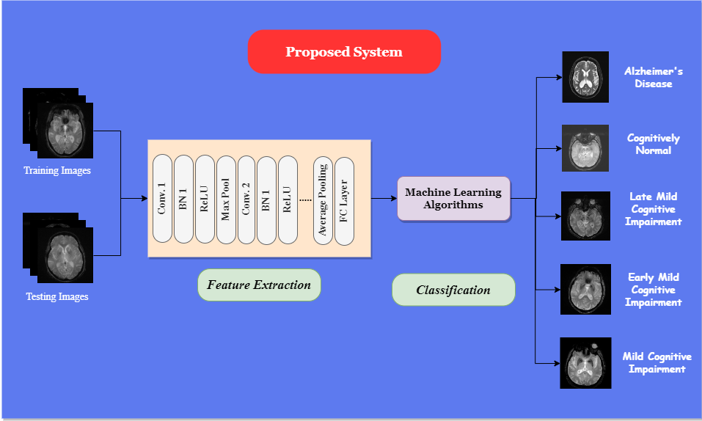
Proposed Architecture

Slide 6
Methodology
The proposed methodology for using CNN for feature extraction and Machine Learning algorithms for classification to classify Alzheimer's disease involves:
Collecting a balanced dataset of MRI scans
Preprocessing the data
Using a pre-trained CNN to extract features
Selecting the most relevant features
Classifying the MRI scans using a machine learning algorithm
Evaluating the model's performance
Optimizing the model's hyperparameters and feature selection techniques
Interpreting the results validating the model's results
Deploying the trained model on new, unseen data.

Slide 7
Conclusion
In conclusion, the development of a comprehensive classification system for Alzheimer's disease using machine learning can potentially aid in early detection and accurate diagnosis of the disease, leading to better treatment and management of symptoms.
Ultimately, such a model can have significant clinical implications, improve patient outcomes, and enhance the quality of life for those affected by the disease.

Slide 8
THANK YOU
The TRIDENT
AMRITA VISHWA VIDYAPEETHAM, SCHOOL OF ENGINEERING, CHENNAI CAMPUS

